Slide 1
Battleship Tutorial
Click to Start

Slide 2
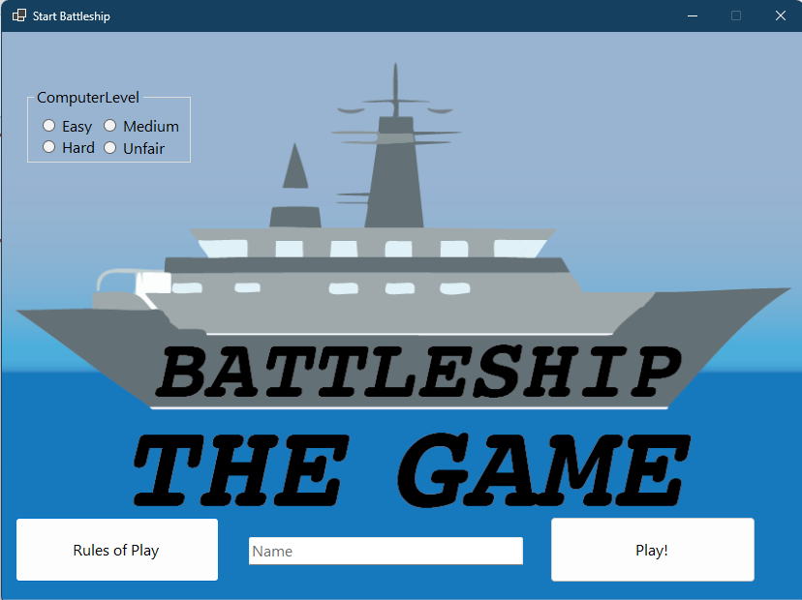
Welcome to Battleship!
This tutorial will explain how to play the game.
When you are ready, click the battleship to start.

Slide 3
Let’s start by choosing the computer difficulty. We will start with the Easy Difficulty.
Click it.

Slide 4
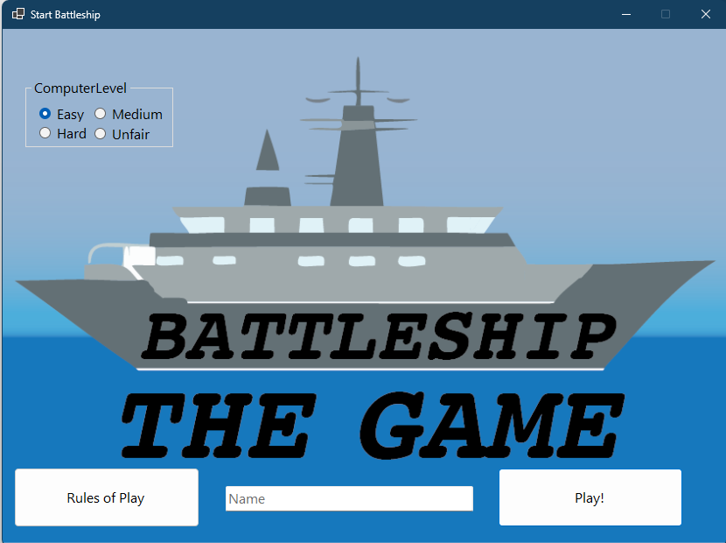
Nice!
Now let’s enter a name. Click on the text field and enter a name.

Slide 5
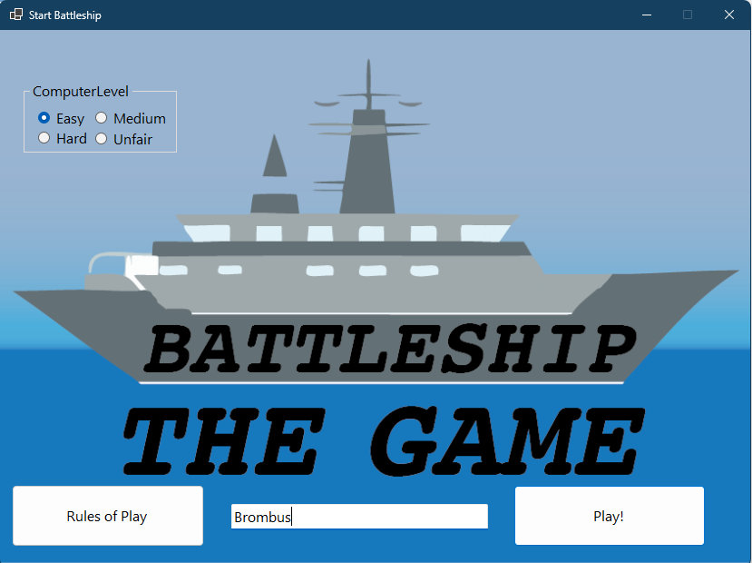
We are ready to play now. When you are ready to go, click Play!

Slide 6
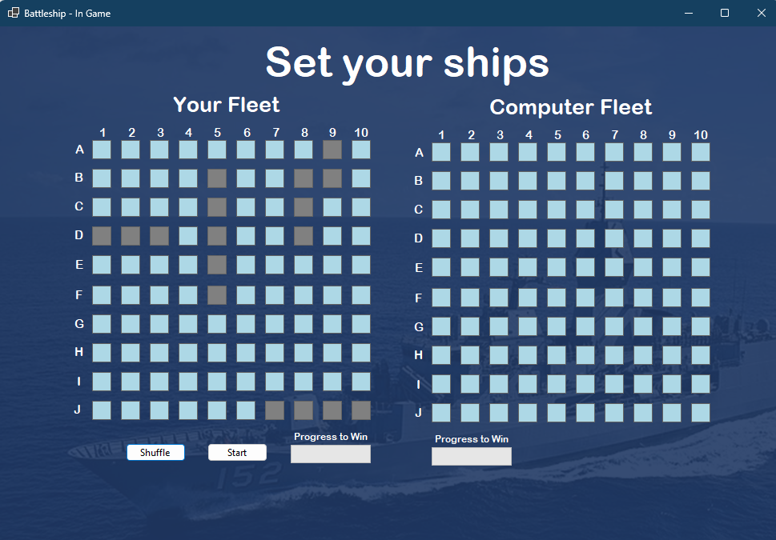
Before we start, we need to set our ships on our grid.
This arrangement doesn’t look too good. Let’s shuffle it.
Click Shuffle

Slide 7
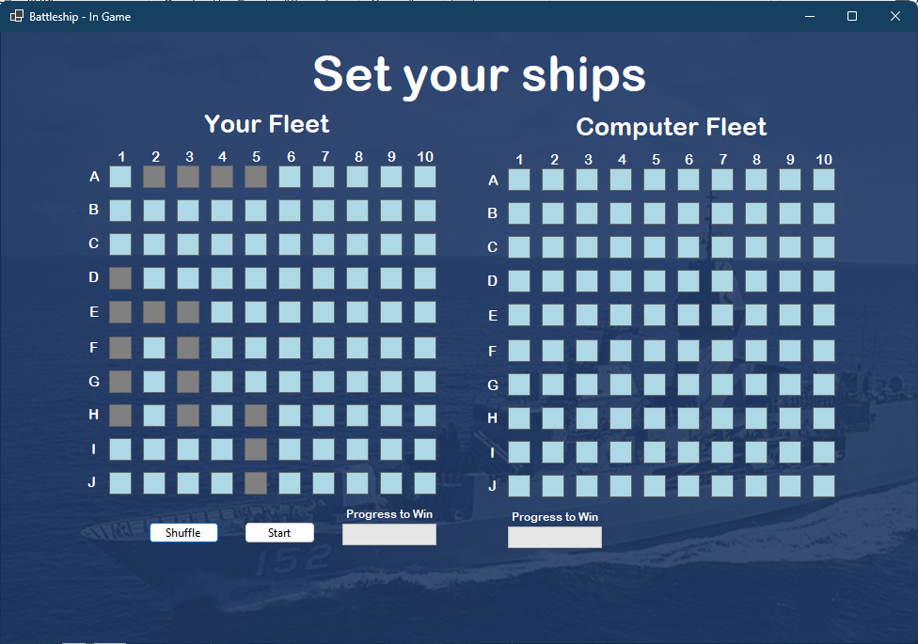
This looks better. The crowded ships will be difficult to guess.
We are ready to start the game now.
Click Start

Slide 9
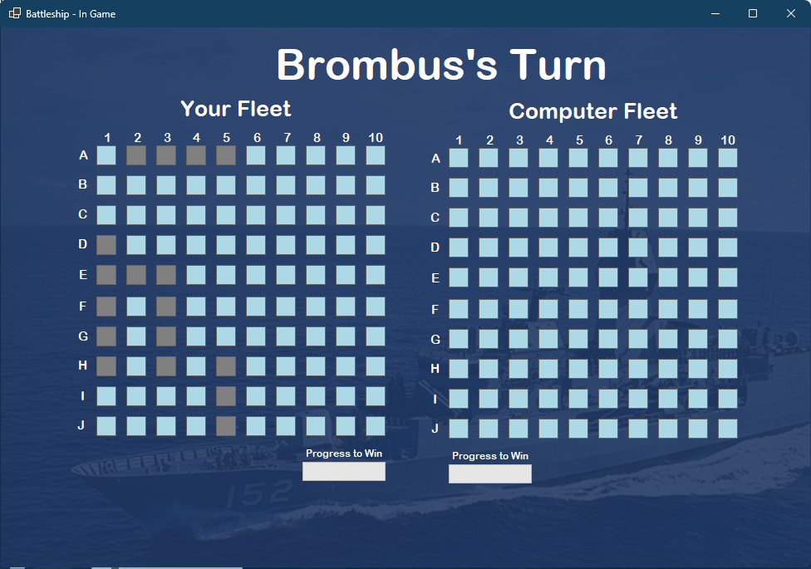
It’s time for our first move!
Click on E5 to make a guess

Slide 10
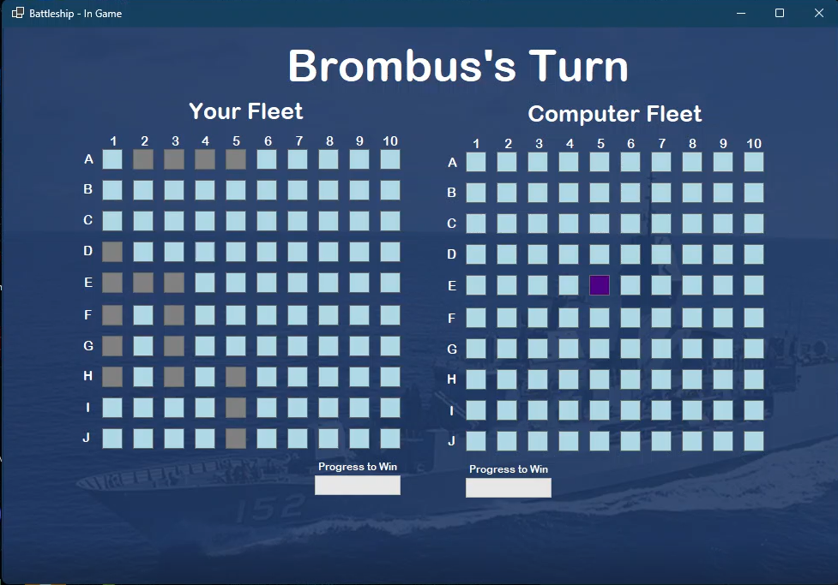

Slide 14
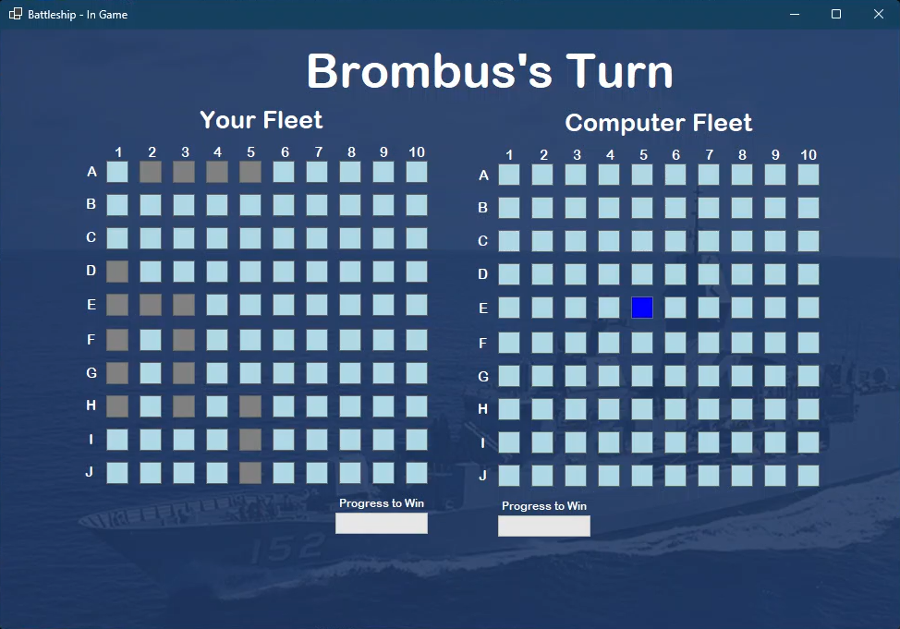

Slide 15
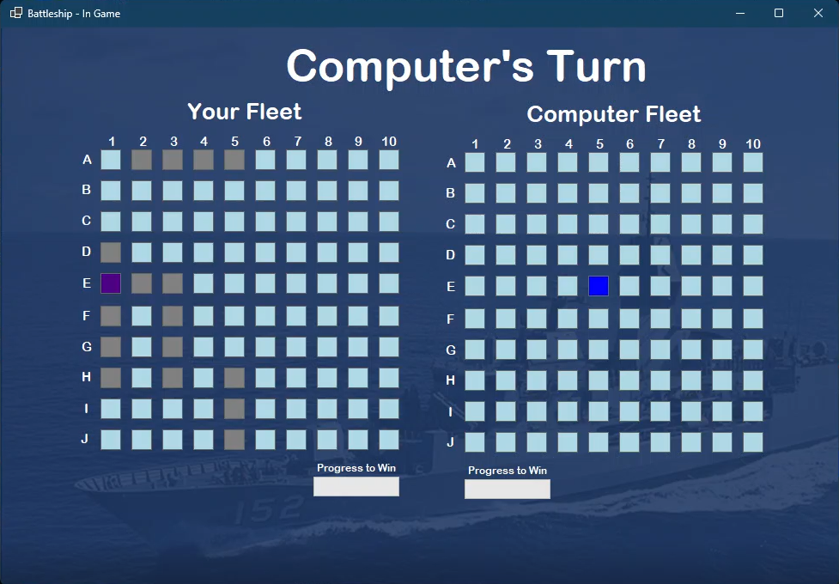

Slide 16


Slide 19
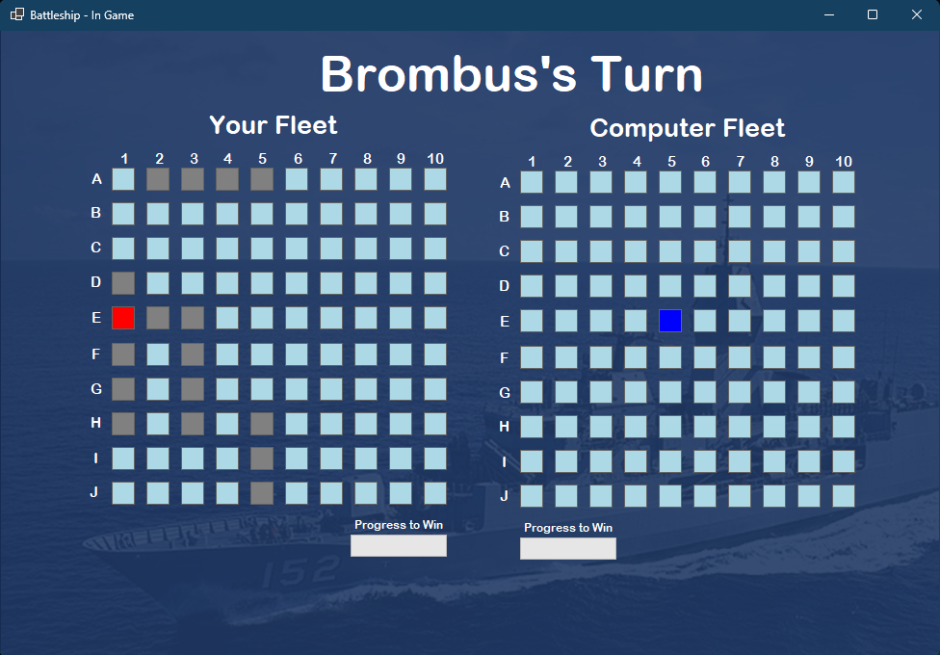

Slide 21
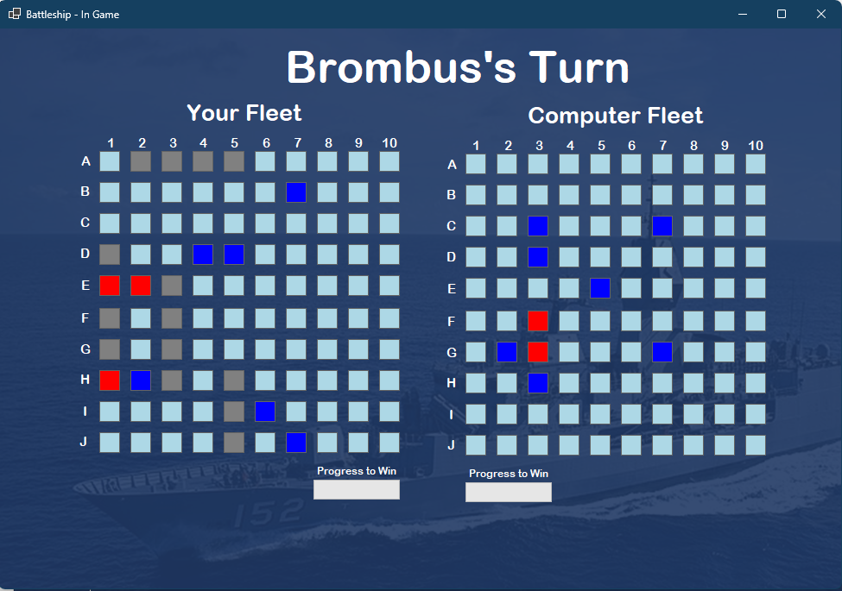

Slide 22
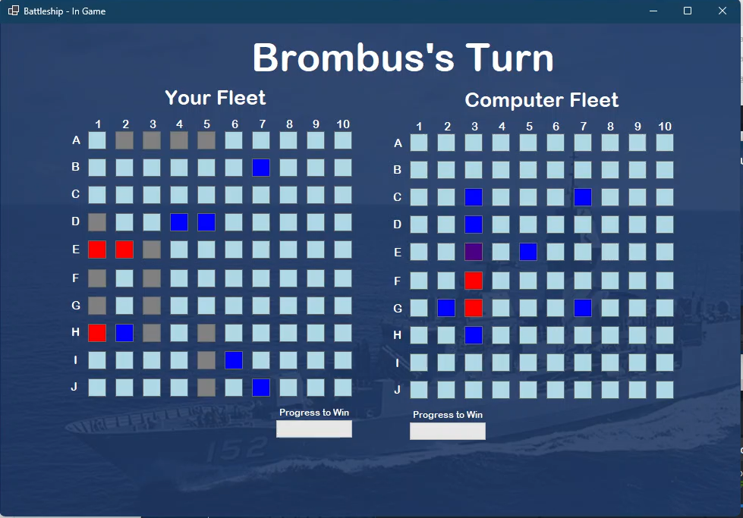

Slide 23
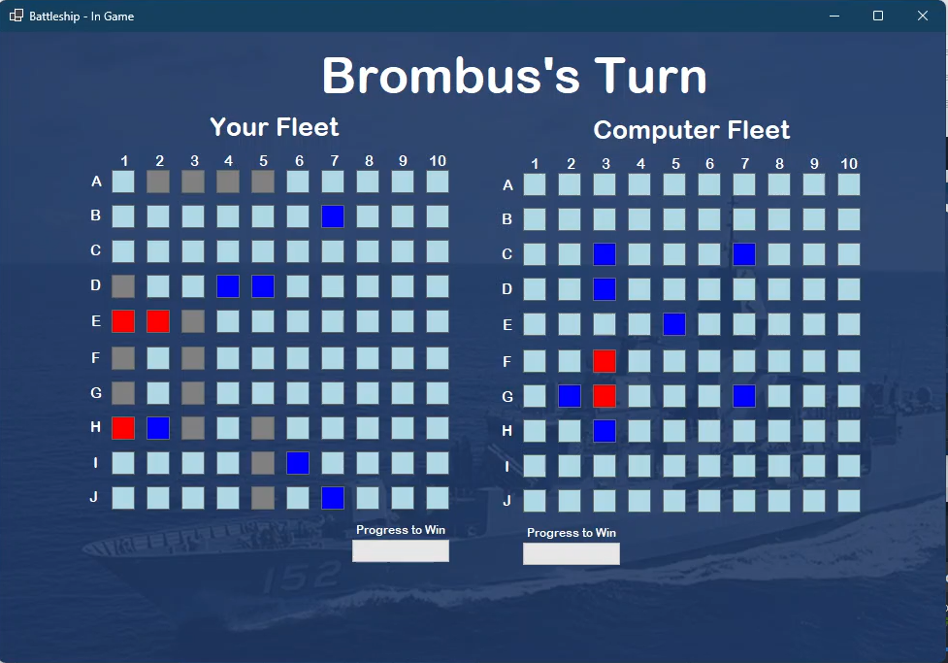

Slide 24
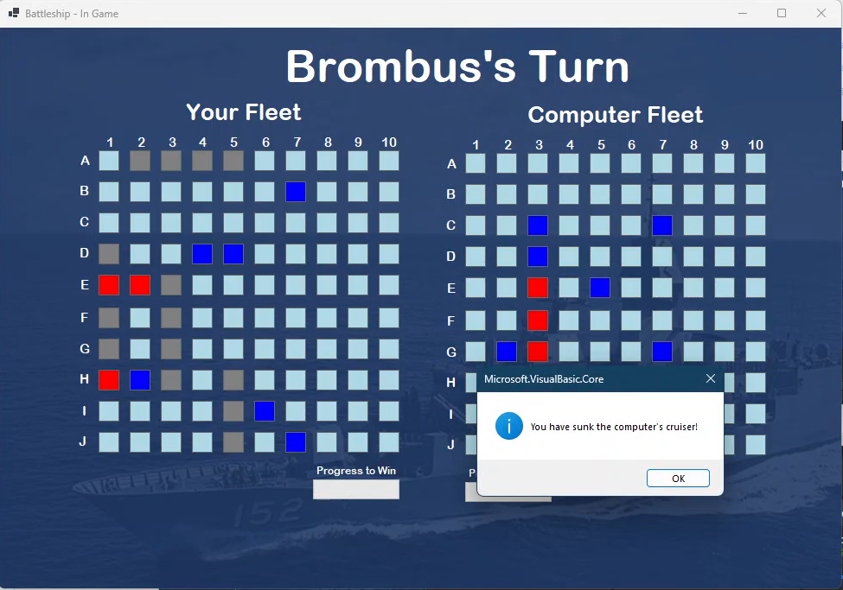

Slide 25
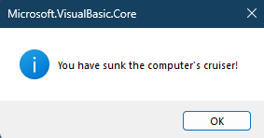

Slide 26
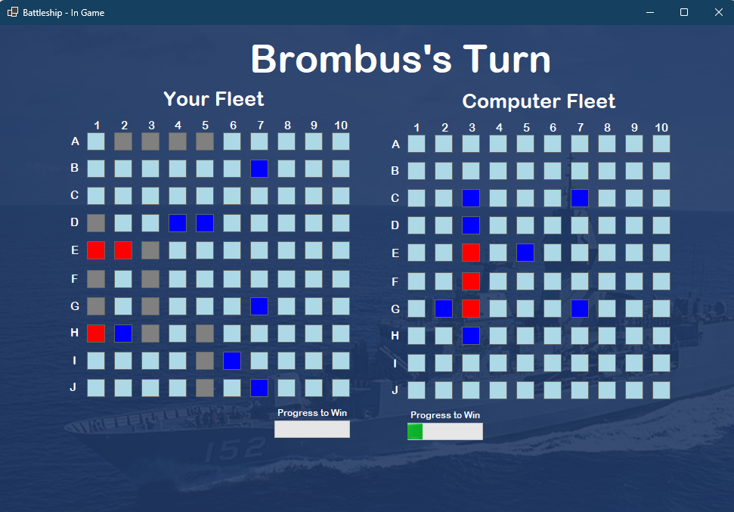

Slide 27
